Slide 1

20CS7503 - DESIGN PROJECT – 3
WAVELET-BASED LUNG CANCER CLASSIFIER
WITH GESTURE INTERFACE
BATCH NUMBER - 7

Slide 2
WAVELET-BASED LUNG CANCER CLASSIFIER
WITH GESTURE INTERFACE
DOMAIN : AI AND DEEP LEARNING IN HEALTHCARE
GUIDED BY,
Ms.P. KARTHIKA
TEAM,
SANJANA M (811721104088)
SWATHI S (811721104110)
SWETHA S (811721104112)

Slide 3
OBJECTIVE
The Objective is to propose an automated lung cancer diagnosis from the given input
lung image.
To classify the lung cancer and its severity along with gesture interface.

Slide 4
LITERATURE SURVEY
Title of Paper | Author(s) | Technology Used | Paper Content | Year
Self-Upgraded Cat Mouse Optimizer With Machine Learning Driven Lung Cancer | Ragab.M, Katib.I, Sharaf.S.A, Assiri.F.A, Hamed.D and Ghamdi.A | Machine Lerning | Self-Upgraded Cat Mouse Optimizer with Machine Learning Driven Lung Cancer Classification | 2009
Multi-Orientation Local Texture Features for Guided Attention-Based Fusion in Lung Nodule Classification | Saihood,A., Karshenas,H, Naghsh-Nilchi,A.R | Multi-orientation-based Guided-attention Module (MOGAM) | Provides high flexibility in concentrating on the relevant information extracted from different regions of the nodule in a non-local manner | 2023
An enhanced computer- assisted lung cancer detection method using content based image retrieval and data mining techniques | Muthazhagan,B. Ravi,T. Rajinigirinath,D. | Support Vector Machine (SVM) | Computer- assisted lung cancer detection | 2020

Slide 5
ARCHITECTURAL DESIGN FOR EXISTING SYSTEM
Input CT scan Image
Image Processing geometric mean filter
Classification- ANN, KNN, RF
Feature extraction
LDA algorithm
Lung cancer prediction

Slide 6
EXISTING SYSTEM
MANUAL DIAGNOSIS
Current diagnostic methods involve manual analysis of CT scans by radiologists.
Time-consuming and prone to human error, especially for subtle patterns in nodules.
CONVENTIONAL MACHINE LEARNING TECHNIQUES
Algorithms like K-Nearest Neighbors (KNN), Decision Tree (DT), and Logistic Regression (LR) are used.
These rely heavily on handcrafted features, leading to limited accuracy and challenges in handling complex image patterns.

Slide 7
CHALLENGES ON EXISTING SYSTEM
Limited availability of high-quality lung CT scan datasets.
Imbalanced datasets lead to biased classification results.
DWT and evolutionary algorithms increase computational complexity.
Efficient implementation is needed for large-scale datasets.

Slide 8
PROPOSED SYSTEM
It uses deep learning, specifically Convolutional Neural Networks (CNN), with Moth Flame Optimization (MFO) and Salp Swarm Optimization (SSO) algorithms to enhance lung cancer detection in CT images.
Wavelet preprocessing extracts features, and MFO optimizes CNN hyperparameters. SSO refines feature selection for better classification and accuracy.
The system integrates a gesture-based interface for hands-free operation, streamlining interactions for medical professionals.

Slide 9
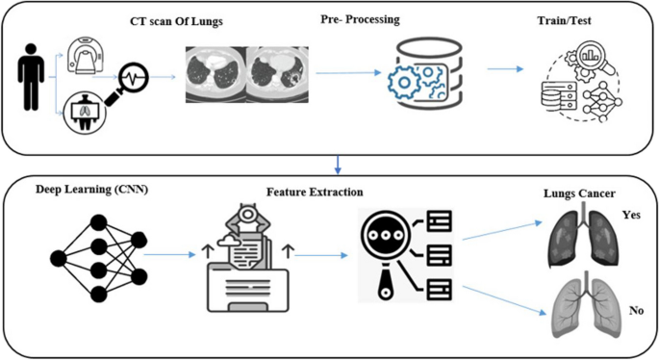
ARCHITECTURAL DESIGN FOR PROPOSED SYSTEM
FEATURE LEARNING AND CLASSIFIER
Input Lung Image
Pre-Processing
(Wavelet Transform)
Image Segmentation
Feature Selection
(MFOSSO)
Feature Extraction
(DTCWT)
CNN
FEATURE EXTRACTION
LUNG CANCER
YES
NO

Slide 10
HARDWARE AND SOFTWARE REQURIMENTS
HARDWARE
SOFTWARE
Memory i.e RAM with 4-8 GB
Power Supply
Connectivity to camera
Google Colab
Google Drive
PyCharm 2023.3.5
Open CV - Gesture Control

Slide 11
MODULES
PREPROCESSING
IMAGE SEGMENTATION
FEATURE SELECTION
CLASSIFICATION
GESTURE CONTROL
DECISION MAKING

Slide 12
MODULE - 1
PREPROCESSING
Data Acquisition
Collect CT scan images of lung tissues for analysis, ensuring high- resolution and noise-free inputs.
Image Enhancement
Apply wavelet-based preprocessing techniques to enhance image quality, improve contrast, and highlight critical features.
Noise Removal
Use filters and normalization methods to remove noise and artifacts for clearer image representation.

Slide 13
MODULE - 2
2. IMAGE SEGMENTATION
Region of Interest (ROI) Isolation
Identify and isolate potential lung nodules from CT scan images to focus on areas crucial for cancer detection.
Adaptive Thresholding
Utilize adaptive thresholding techniques to segment lung tissues by separating nodules from the background.

Slide 14
MODULE - 3
3. FEATURE SELECTION
Moth Flame Optimization (MFO):
Utilizes this optimization algorithm to select a subset of the most relevant features from the extracted data, enhancing the model’s performance and reducing computational complexity.
Salp Swarm Optimization (SSO):
Applies this optimization technique to further refine the feature selection process by evaluating feature importance and redundancy, ensuring the selected features improve classification accuracy.

Slide 15
MODULE-4
4. CLASSIFICATION
The extracted features are fed into fully connected layers to predict outcomes.
CNN classifies the CT images into categories (e.g., benign or malignant).
It outputs the probability of each class, ensuring an accurate and datadriven decision-making process.

Slide 16
MODULE - 5
5. GESTURE CONTROL
Hand Movement Recognition
Use camera-based input systems to detect and track hand gestures for a hands-free interface, improving accessibility.
Interface Control
Enable users to navigate and operate the system by predefined gestures, eliminating the need for physical touch

Slide 17
MODULE - 6
6. DECISION MAKING
Classification-Based Decision Making:
The module utilizes the classification outcomes from the CNN algorithm to determine whether the detected lung nodule is malignant or benign, ensuring precise diagnostic decisions.

Slide 18
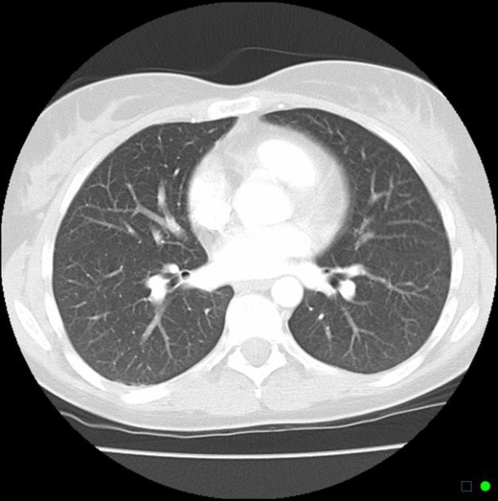
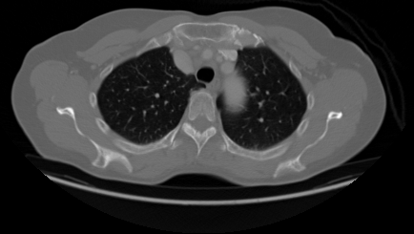
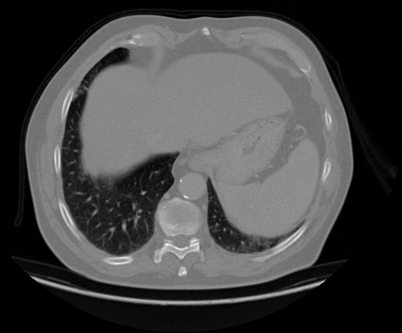
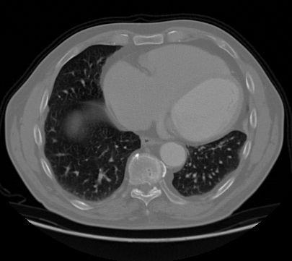
INPUT
Normal 627 x 627
Adenocarcinoma 450 x 450
Large cell Carcinoma 435 x435
Squamous 405 x 405

Slide 19
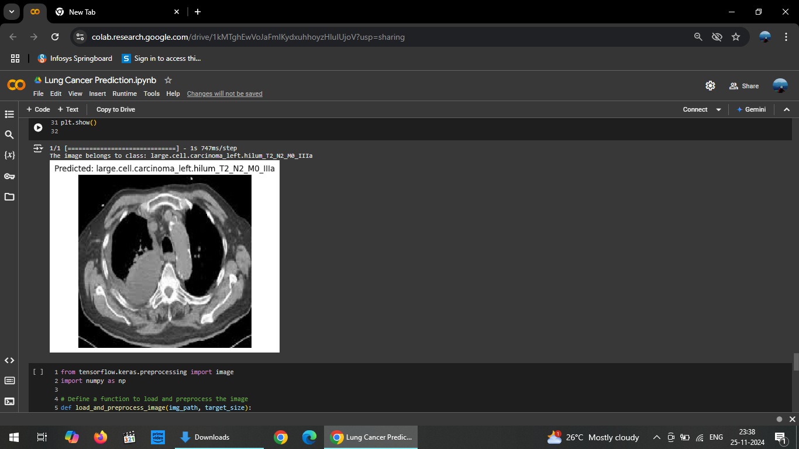
OUTPUT

Slide 20
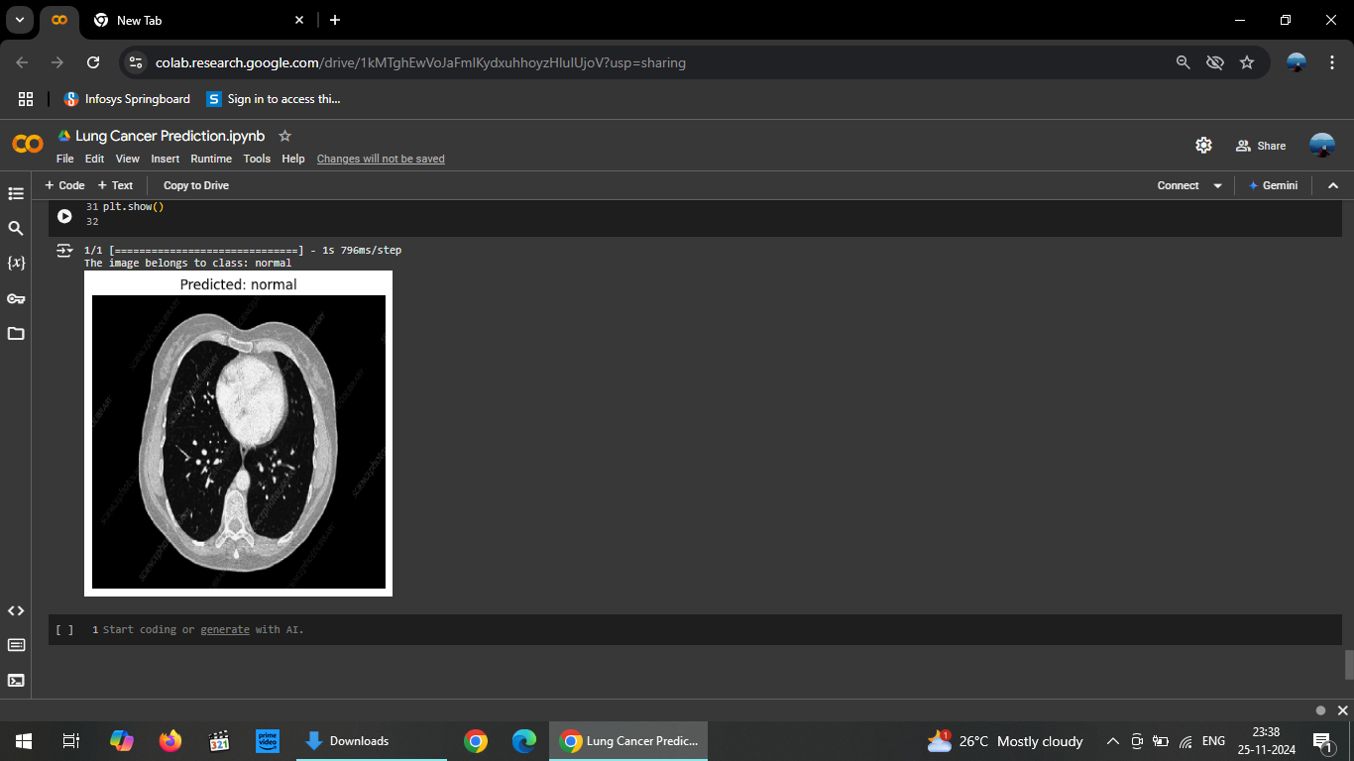
OUTPUT

Slide 21
CONCLUSION & FUTURE ENHANCEMENT
CONCLUSION
This project offers an efficient lung cancer detection system leveraging advanced algorithms like MFO and SSO, CNN alongside gesture control for hands-free operation. The integration of deep learning enhances diagnostic accuracy, providing a cost-effective, adaptable solution.
FUTURE ENHANCEMENT
Future work includes integrating 3D imaging for detailed analysis, improving gesture recognition with voice input, and deploying cloud-based platforms for real-time, remote diagnosis.

Slide 22
THANK YOU

